Slide 1
5.2 Defining the Problem Space - Identifying Requirements and Responsibilities
Christopher (Cal) Lee
callee@ils.unc.edu
June 15, 2016
Open Source Center
Reston, VA, USA
June 9-22, 2016

Slide 2
What are Records?*
“(A) includes all recorded information, regardless of form or characteristics, made or received by a Federal agency under Federal law or in connection with the transaction of public business and preserved or appropriate for preservation by that agency or its legitimate successor as evidence of the organization, functions, policies, decisions, procedures, operations, or other activities of the United States Government or because of the informational value of data in them; and
(B) does not include—
(i) library and museum material made or acquired and preserved solely for reference or exhibition purposes; or
(ii) duplicate copies of records preserved only for convenience.”
“’recorded information’ includes all traditional forms of records, regardless of physical form or characteristics, including information created, manipulated, communicated, or stored in digital or electronic form.”
*44 U.S. Code § 3301 - Definition of records (emphasis mine)

Slide 3
“Official records document the organization, functions, policies, decisions, procedures, operations, and other activities related to conducting business.”
“Abstract Data Definition for Electronic Records Management,” Version 2014-DEC, Intelligence Community Technical Specification, Office of the Director of National Intelligence, December 22, 2014.

Slide 4
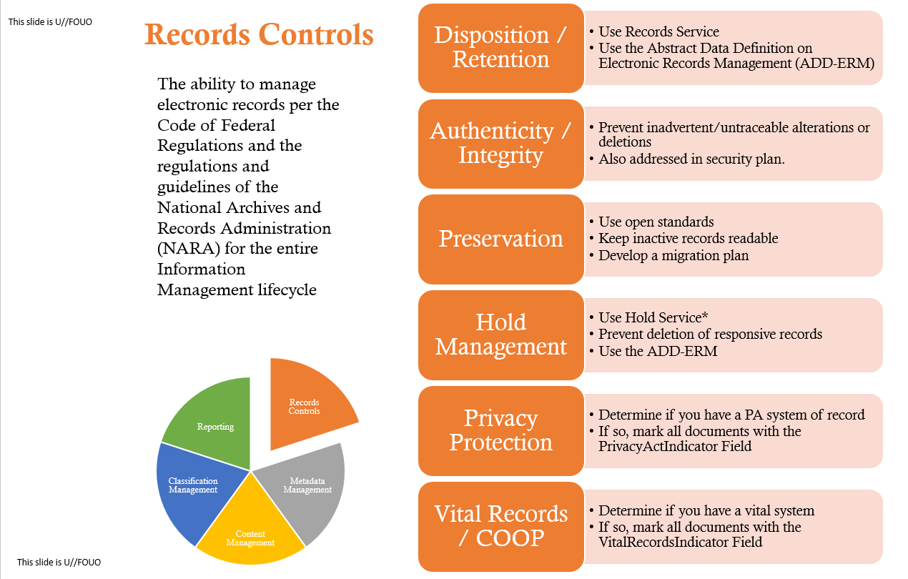
Source: “Information Management Approval Requirements.” OSC.

Slide 5
Source: “Information Management Approval Requirements.” OSC.

Slide 6
“You can’t have everything. Where would you put it?” - Stephen Wright

Slide 7
Appraisal
Frequently identified as most important ARM function
Identification of the few (1-5%) records worth preserving, I.e. those with continuing value
Largely a result of records volume explosion in mid-20th century
Shift from collector to selector role (reduction of bulk)

Slide 8
Retention Scheduling
For active/semi-active records
Retention schedule elements
Series label
Description
Retention Period
Disposition Action
Legal or other authority

Slide 9
Retention Scheduling
Two main types of schedules: general & specific
Traditionally based on series, but often now based instead on systems or functions

Slide 10
Format and Content of Retention Schedules
Format and presentation varies significantly
Common elements:
Series name
Series description
Period – how long (absolute time or event-based)
Disposition – what to do at end of period
Authority – basis for assigning above period & disposition (often statute or policy)
Schedules can be general (apply across the entire enterprise, such as all of the federal government) or unit-specific (e.g. only for one government agency)

Slide 11
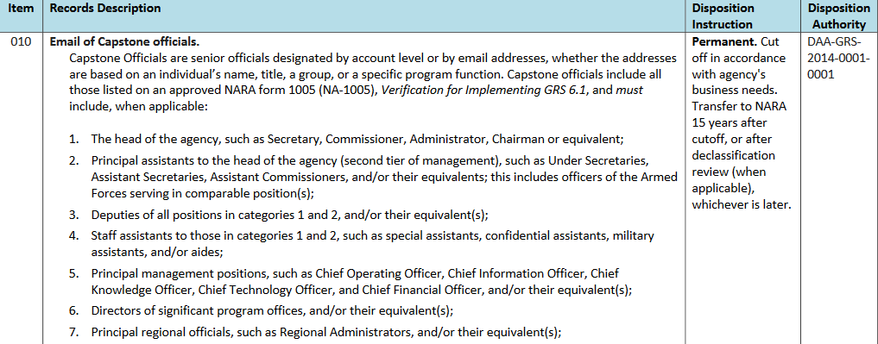
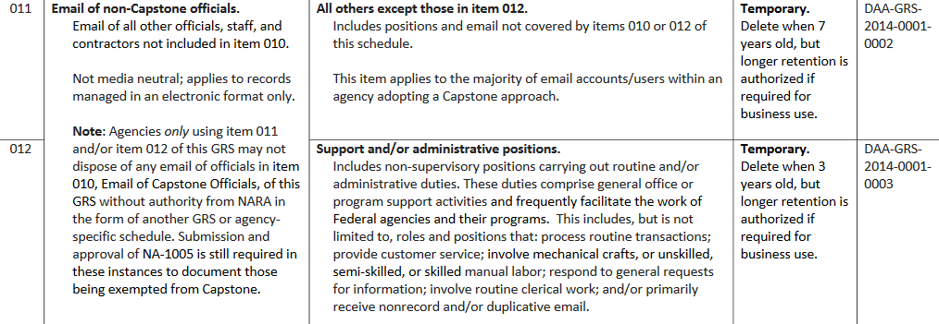
General Records Schedule (GRS) Example
“General Records Schedule 6.1: Email Managed under A Capstone Approach,” Transmittal No. 25, September 2015 (updated 03/2016)

Slide 12
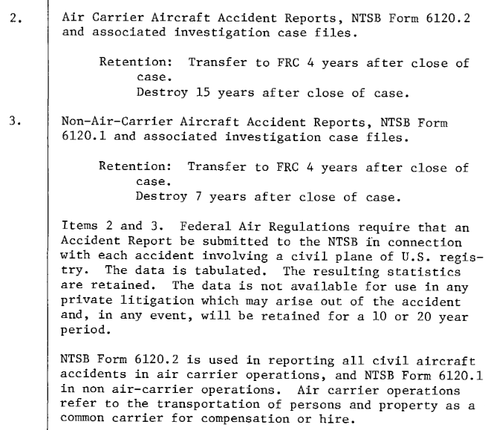
Agency-Specific Retention Schedule Example - NTSB
Request for Authority to Dispose of Records, National Transportation Safety Board, January 3, 1978.

Slide 13
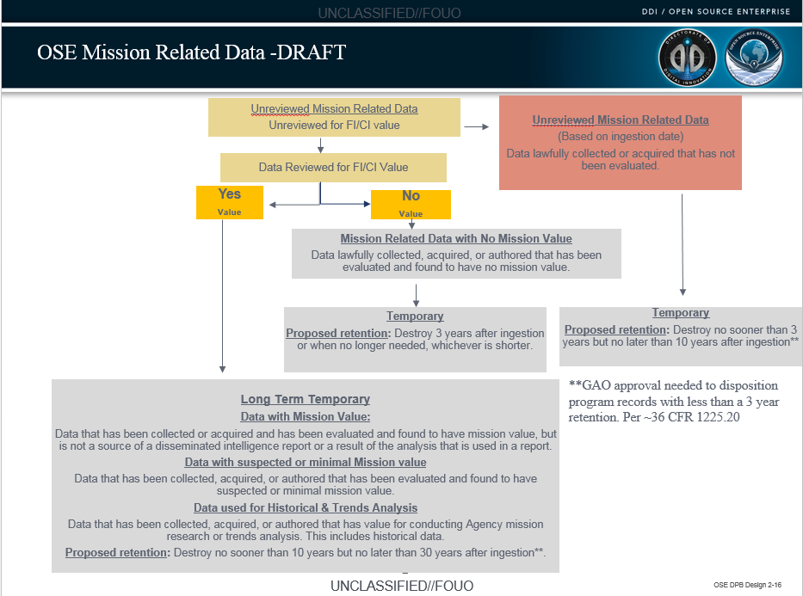
OSE – Mission Related Data – DRAFT, August 1, 2016.

Slide 14
Source: “Information Management Approval Requirements.” OSC.

Slide 15
Holds - Suspension of Disposition Actions
When receiving notice or having reasonable anticipation of litigation, must cease normal disposition actions that would destroy related data, e.g.
Implementing deletion based on retention schedules
Recycling of backup tapes
Perhaps even defragmenting hard drive

Slide 16
IC Hold Types
Hold Type | Category of Hold
Congressional Inquiry | Records relating to an agency's congressional affairs office ongoing searches and congressional inquiries
Financial | 1. Records retired before contract close-out, final payment, and/or settlement 2. Records under review for confirmation of payment, undergoing financial audits, and Certifications
FOIA/PA/MDR | Records associated with open FOIA/PA/MDR requests
Historical Review | Records determined by the History Staff to be of historical significance
Investigations, Audits and Inspections | Records relating to pending Inspector General's office and other offices' investigations, inspections and audits
Litigation | Records relating to the General Counsel's Office and other offices' ongoing legal actions
Markings Hold | Record has classification or dissemination control marking(s) that prevent the record from being transferred to NARA. For example: LIMDIS, RD (Restricted Data) and Declassification Review Pending"
Mission Critical | Records associated with ongoing operations, projects and/or programs
Records Manager Hold | 1. Records requiring Records Manager/Custodian review 2. Waiting for NARA approval of proposed new disposition 3. Records relating to/from office reorganization 4. Records retired under wrong Record Control Schedule (RCS) and/or incorrect RCS Item Number 5. Inactive records retired prior to cutoff 6. Disposition time miscalculated
Abstract Data Definition for Electronic Records Management, Version 2014-DEC, Intelligence Community Technical Specification, December 22, 2014.

Slide 17
Source: “Information Management Approval Requirements.” OSC.

Slide 18
Reliability*
Authority & trustworthiness of a record as evidence
Records ability to stand for the facts / entity of which it is evidence & treated as that fact in itself (e.g., passport = citizenship)
Provided by a record’s
form (e.g., date, signature)
procedure of creation (signing authority, routing, handling during compilation & completion, filing, etc.)
*Duranti, Luciana. "Reliability and Authenticity: The Concepts and Their Implications." Archivaria 39 (1995): 5-10.

Slide 19
Authenticity
Hasn’t been subject to undocumented manipulation
Essential characteristics of the record can still be reproduced on current technology
Technological (e.g. checksums, digital signatures) and procedural (e.g. security, monitoring of changes to technology or users’ knowledge base) elements

Slide 20
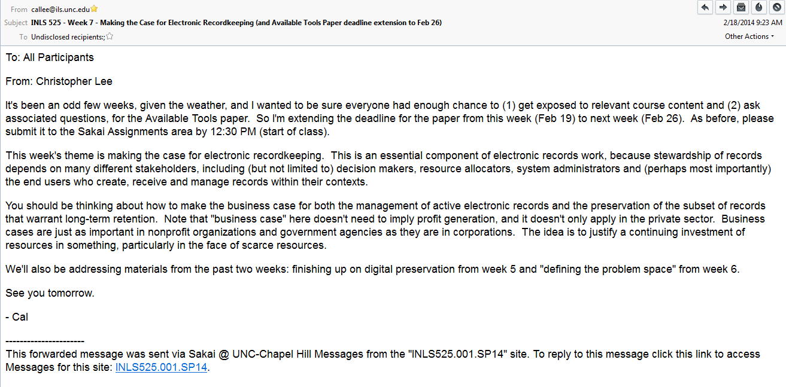
Essential Characteristics of Records
Content

Slide 21
Essential Characteristics of Records
Context

Slide 22
Essential Characteristics of Records
Structure

Slide 23
Focus on recordkeeping systems, rather than individual records

Slide 24
Data Sources as Records
“The producer must generate and retain a fully-sourced version of every disseminated analytic product-- including downgraded, sanitized, or tear-line products-- as a document of record and deposit it in an official record keeping system unless exempted…”
Intelligence Community Directive Number 206. “Sourcing Requirements For Disseminated Analytic Products.” Effective: October 17, 2007. (Emphasis Added)

Slide 25
Document Management System vs. Records Management System
What are the main features of a document management system?
What does an electronic records management system add to this?

Slide 26
Warrant
Derived from laws, regulations, case law, IT standards, auditing standards, best practices that suggest or mandate particular recordkeeping behavior*
*Duff, Wendy. "Harnessing the Power of Warrant." American Archivist 61 (1998): 88-105.

Slide 27
Importance of Warrant for Electronic Recordkeeping
Activity | Relevance of Warrant
Advocacy and outreach | Making the best case to the producer for how and why digital curation is important
Acquisition planning | Predictor of what is likely to be produced and retained over time
Description | Providing documentation of why materials were created and retained
Preservation planning | Understanding why materials were created and retained is fundamental to identifying significant properties
Ensuring sustainability | Service offerings that can be directly mapped to producer’s requirements/incentives can be much more likely to receive funding over time

Slide 28
Character and structure of artifacts are often very closely tied to character and structure of organizations/systems that created and originally stored them.

Slide 29
Conway’s Law*
“...the very act of organizing a design team means that certain design decisions have already been made, explicitly or otherwise. Given any design team organization, there is a class of design alternatives which cannot be effectively pursued by such an organization because the necessary communication paths do not exist. Therefore, there is no such thing as a design group which is both organized and unbiased."
“...organizations which design systems (in the broad sense used here) are constrained to produce designs which are copies of the communication structures of these organizations.”
*Conway, Melvin E. "How Do Committees Invent?" Datamation 14, no. 4 (1968): 28-31. [emphasis added]

Slide 30
Likewise, recordkeeping systems reflect organizational structures and behaviors
See e.g.: Yates, JoAnne. Control through Communication. Baltimore: Johns Hopkins University Press, 1989.

Slide 31
Steps in a systematic characterization, analysis and evaluation of a recordkeeping environment

Slide 32
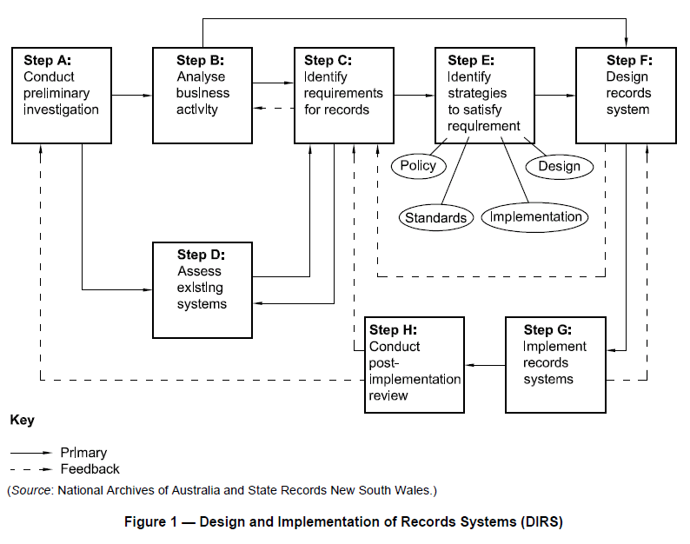
"Information and Documentation - Records Management - Part 2: Guidelines.“ ISO 15489-2:2001.

Slide 33
Designing and Implementing Record Keeping Systems (DIRKS)
“DIRKS: A Strategic Approach to Managing Business Information," National Archives of Australia, 2001 (Updated in 2003)
Basis for ISO 15489 figure on previous slide
Elaborates each step in more detail

Slide 34
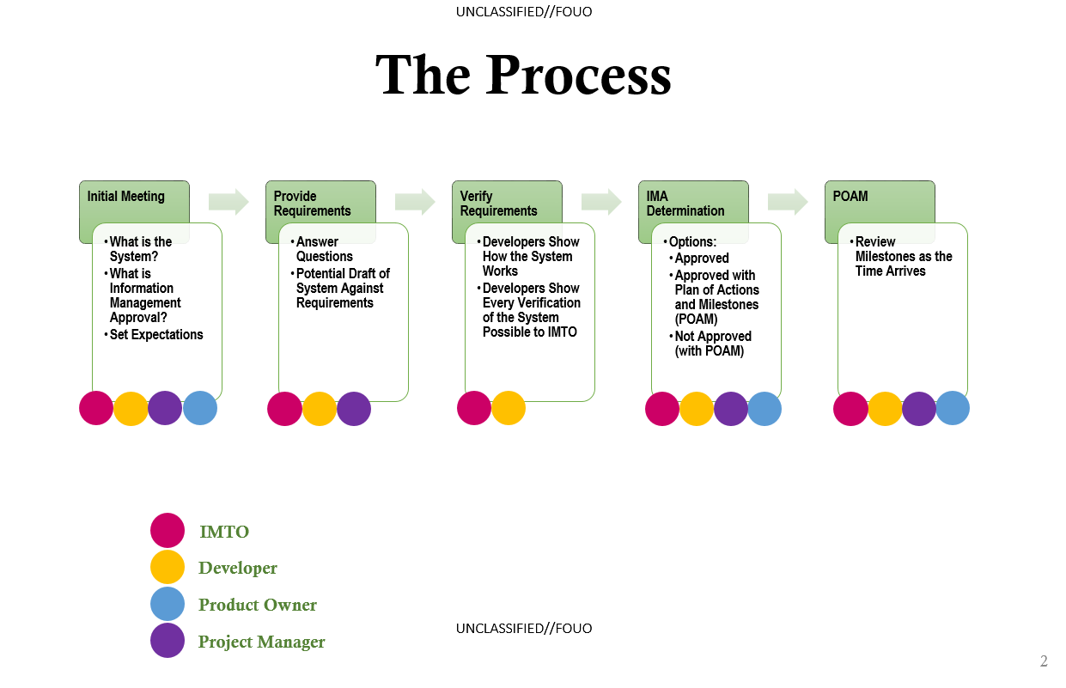
Source: “Information Management Approval Requirements.” OSC.

Slide 35
Doing Good Electronic Recordkeeping

Slide 36
Reflecting purposes – understanding and attending to intentions of creators and “primary users”

Slide 37
Capturing the state of information from dynamic environments
Two fundamental options
Snapshot of entire state at point in time
Accounting for changes to information over time (e.g. change logs and audit trails)

Slide 38
Avoiding Unnecessary Lock-In
“How do I get this stuff out when I stop using this particular system?”
Hint: “No worries. You’ll always be using this system.” is not the right answer

Slide 39
Unlocking from Lock-in
Getting files off removable media without doing irreversible harm
Dealing with obsolete formats and platforms

Slide 40
Promoting Discovery through Intellectual Control
Description
Naming conventions
Mappings across inconsistent terminologies

Slide 41
Promoting Sensemaking
“Now I have it, but what am I looking at?”
Creating, capturing, or extracting information for making sense of things being used

Slide 42
Acting Locally, but Thinking Globally
Who might I hand these things off to in the future?
How would that work?
What are the likely motivations and needs of the recipient?

Slide 43
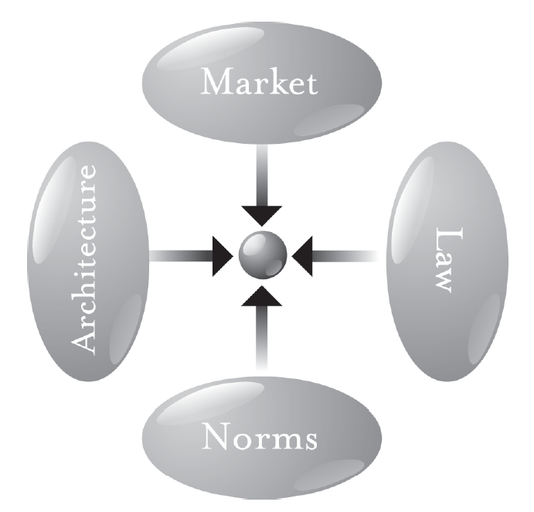
Explore Multiple Modalities
Identify the values to advance, then address the modalities that pose the greatest threat or opportunity
Lessig’s biggest lesson: the future nature of cyberspace is not predetermined; it’s up to us
Lessig, Lawrence. Code: Version 2.0. New York, NY: Basic Books, 2006.

Slide 44
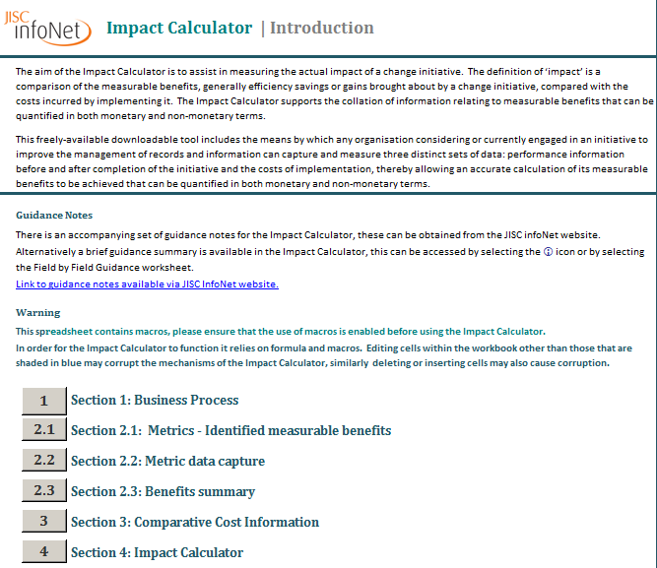
http://www.jiscinfonet.ac.uk/records-management/measuring-impact/impact-calculator/index_html

Slide 45
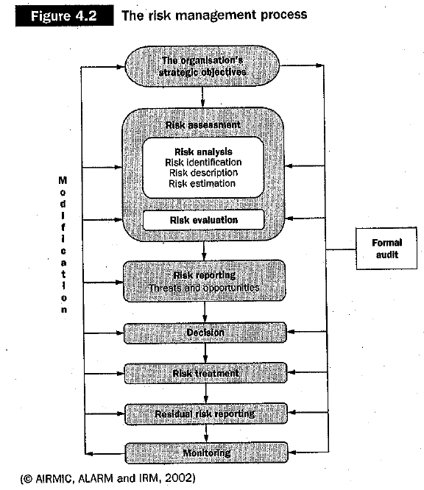
The Other Side: Risk Management
Source: Mat-Isa, Azman. "Risk Management and Managing Records." In Record Keeping in a Hybrid Environment: Managing the Creation, Use, Preservation and Disposal of Unique Information Objects in Context, edited by Alistair G. Tough and Michael Moss, 69-83. Oxford: Chandos, 2006.

Slide 46
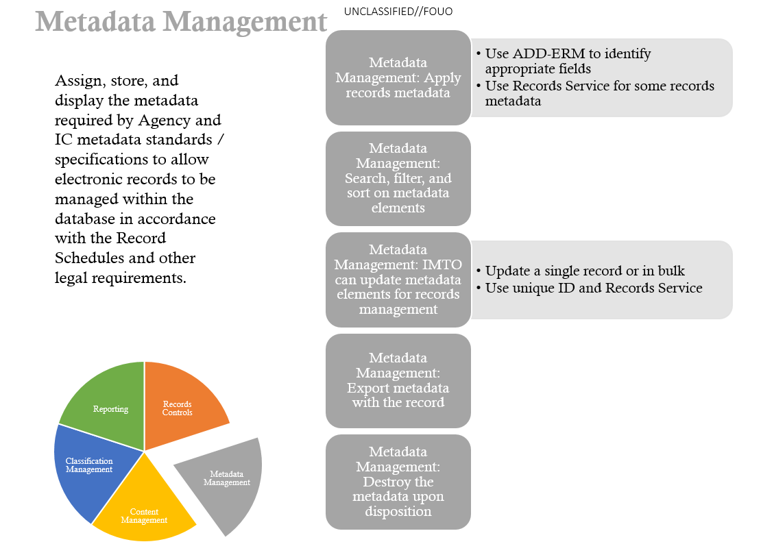
Source: “Information Management Approval Requirements.” OSC.

Slide 47
A Core Set of Requirements for Digital Curation: Characterization

Slide 48

The “Lifting Problem” in Digital Curation
Reuse of digital object requires “lifting”¹ it out of its original context, then making sense and use of it in new context
Support for lifting requires proper balance between:
Providing too little contextual information, so that the user does not understand what she is interacting with, and
too much contextual information, so that she “will drown in unnecessary, unhelpful, or conflicting data”²
Guha, R., and John McCarthy. "Varieties of Contexts." In Modeling and Using Context: 4th International and Interdisciplinary Conference Context 2003 Stanford, CA, USA, June 23-25, 2003 Proceedings, edited by Patrick Blackburn, Chiara Ghidini, Roy M. Turner and Fausto Giunchiglia, 164-77. Berlin: Springer, 2003.
Ackerman, Mark S., and Christine Halverson. "Considering an Organization's Memory." In CSCW '98: Proceedings: ACM 1998 Conference on Computer Supported Cooperative Work, Seattle, Washington, November 14-18, 39-48. New York, NY: Association for Computing Machinery, 1998.
Image source: http://coachrobbrogers.com/wp-content/uploads/2012/08/weight_lifting1.gif

Slide 49
Interpretation and use of a digital object often depends heavily on representations that object carries within itself, i.e. part of the bitstream But this is often insufficient, on its own, for digital curation.

Slide 50
Inherent Limits of Lifting
You could not step twice into the same river; for other waters are ever flowing on to you.
- Heraclitus
No digital object can carry all of its context along with itself
There is no such thing as a digital monad (Leibniz), i.e. fully self-contained, self-describing digital object that represents the entire universe (full elaboration of all types of context) that surrounds itself

Slide 51
Dangers of Omission and Commission¹
Without access to sufficient contextual information, a user agent (person, application) can:
suffer from gaps in understanding, but also
based on the propensity to make sense and reduce cognitive dissonance², incorrectly “fill in the gaps” based on characteristics of current context.
“The greater the degree of remoteness, the greater is the danger that a temporary and legitimate failure to express reference to context will be converted into a virtual denial of its place and import.”³
1. Lee, Christopher A. “Taking Context Seriously: A Framework for Contextual Information in Digital Collections.” UNC SILS TR-2007-04. October 18, 2007.
2. Weick, Karl E. Sensemaking in Organizations. Thousand Oaks, CA: SAGE Publications, 1995.
3. Dewey, John. "Context and Thought." University of California Publications in Philosophy 12, no. 3 (1931): 203-24.

Slide 52
One “cannot, in general, directly observe digital data and instead they can only observe the data displayed on a monitor or other output device, which is driven by various types of hardware and software. Because the observation of the data is indirect, a hypothesis must be formulated that the actual data is equal to the observed data.”
Carrier, Brian D. "A Hypothesis-Based Approach to Digital Forensic Investigations." Doctoral Dissertation, Purdue University, 2006. p.11, emphasis added

Slide 53
Characterize “To describe or delineate the character or peculiar qualities of (a person or thing)” (Oxford English Dictionary, Second Edition, 1989)

Slide 54
Characterizations = Surrogate Representations
Assertions about specific aspects of the content or character of a digital object
Can be:
Very specific and machine-readable (e.g. file = 25 bytes; character-encoding = UTF-8, image is 48 pixels wide)
Relatively vague and human-readable (e.g. “This is a video from YouTube”; “I was able to view this on a Macintosh”)
Or somewhere in between

Slide 55
Reasons to Create Characterizations to Store Separate from the Bitstream
Less dependence on application-specific formats/encodings
Efficiency of processing (e.g. searching index vs. raw text)
Efficiency of transfer (e.g. cache copy of data closer to where it’s needed, only transfer metadata rather than whole bitstream)
Can use external characterizations to “bootstrap” effective use of bitstream content
Redundancy eliminates single point of failure (e.g. corruption of header making file unreadable)
Change of characterization metadata doesn’t require change to the bitstream

Slide 56
Another Reason:
“to verify that the transformed objects are still authentically representing the same intellectual content”
*Becker, Christoph, Andreas Rauber, Volker Heydegger, Jan Schnasse, and Manfred Thaller. "Systematic Characterisation of Objects in Digital Preservation: The Extensible Characterisation Languages." Journal of Universal Computer Science 14, no. 18 (2008): 2936-52.

Slide 57
Important Decision: What to Characterize

Slide 58
Underlying Abstract Form (UAF)*
“Contains all the significant properties of the data, and is independent of the medium upon which the data is written”
“Any given digital object is likely to have a number of possible UAFs.”
“Choice of the UAF for preservation is part of the ingest process”
*Holdsworth, David, and Derek M. Sergeant. "A Blueprint for Representation Information in the OAIS Model." Paper presented at the IEEE Symposium on Mass Storage Systems, College Park, Maryland, USA, March 27-30, 2000.

Slide 59
Two Major Factors for Determining What to Characterize: Genres and Affordances

Slide 60
Genres
“Socially recognized types of communicative actions…that are habitually enacted by members of a community to realize particular social purposes”*
Defining features:
Purpose
Content
Form
*Yates, JoAnne, and Wanda Orlikowski. "Genres of Organizational Communication: A Structurational Approach to Studying Communication and Media." Academy of Management Review 17, no. 2 (1992): 299-326.

Slide 61
Affordances
J.J. Gibson - "Why has man changed the shapes and substances of his environment? To change what it affords him.“
Don Norman - design attentive to inherent links between behavior and perception – e.g. doorknobs, telephones, computer interfaces
*Gibson, James Jerome. The Ecological Approach to Visual Perception. Boston, MA: Houghton Mifflin, 1979. p.130

Slide 62
Genres as Clusters of Affordances
Habituated responses
Embedded in specific sets of practices
Fixity and fluidity are at play*
*Levy, David M. Scrolling Forward: Making Sense of Documents in the Digital Age. New York: Arcade, 2001.

Slide 63
Genres and Affordances in Digital Curation
What characteristics to select for collections and preserve over time?
“…what we perceive when we look at objects are their affordances, not their qualities. We can discriminate the dimensions of difference if required to do so in an experiment, but what the object affords us is what we normally pay attention to.” (Gibson, p.134, emphasis added)
"It is never necessary to distinguish all the features of an object and, in fact, it would be impossible to do so. Perception is economical. 'Those features of a thing are noticed which distinguish it from other things that it is not--but not all the features that distinguish it from everything that it is not.‘” (p.135, emphasis added)
Question: Aim for usability in “vernacular” (Rothenberg) use environment or authenticity through replication of old affordances?

Slide 64
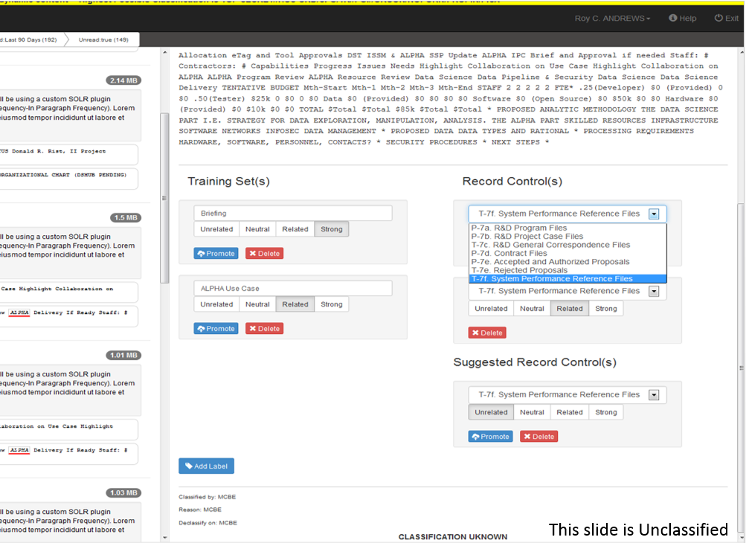
Source: Kathy Sobolewski, “Information Management Services: Machine Learning Briefing to UNC Chapel Hill,” 2016.

Slide 65
Significant Properties
“Properties of digital objects that affect their quality, usability, rendering, and behaviour”*
Often a range of possible values, rather than discrete values, e.g. appearance of email text will vary, but limits to how different content can be and still be "same" message
*Hedstrom, Margaret, and Christopher A. Lee. "Significant Properties of Digital Objects: Definitions, Applications, Implications." In Proceedings of the DLM-Forum 2002, Barcelona, 6-8 May 2002: @ccess and Preservation of Electronic Information: Best Practices and Solutions, 218-27. Luxembourg: Office for Official Publications of the European Communities, 2002.
Notes:
“Whoever takes the decision that a particular digital object should be preserved will have to decide what properties are to be regarded as significant. The submission agreement could usefully specify a list of significant properties.” (CEDARS)1
Essence = “characteristics that must be preserved for the record to maintain its meaning over time”²
1. Holdsworth, David, and Derek M. Sergeant. "A Blueprint for Representation Information in the OAIS Model." Paper presented at the IEEE Symposium on Mass Storage Systems, College Park, Maryland, USA, March 27-30, 2000.
2. 3. Heslop, Helen, Simon Davis, and Andrew Wilson. "An Approach to the Preservation of Digital Records." National Archives of Australia, 2002.

Slide 66
Types of Properties
Type | Description | Sources of Evidence
Supported | By the file format in general | Help files, online documentation, specifications, options in application interface, source code
Observed | Properties of files in given collection - generally addressing higher-level considerations such as types of components, layout & formatting | Inspection of files directly
Measured | Properties of files in given collection that computer can identify directly, without need for human observation | Programs that detect & identify existence of properties
Intended | What creating organization or individual intended to convey | Statements from creators, legal/organizational conventions, patterns of behavior
Notes:
Measured properties are essential area of inquiry, since manual identification should be reserved for initial investigation of new formats/collections, quality assurance on subsets & exceptions

Slide 67
Representation Information
Definition reminder: “Information that maps a Data Object into more meaningful concepts” (OAIS)¹
Allows significant properties to be enacted (reproduced) in given technical environment or set of environments
“No computation without representation”²
Reference Model for an Open Archival Information System (OAIS). CCSDS 650.0-M-2 (Magenta Book). Consultative Committee for Space Data Systems, 2012. [ISO 14721:2012]. Page 1-14.
Smith, Brian Cantwell. "Limits of Correctness in Computers." In Computerization and Controversy: Value Conflicts and Social Choices, edited by Rob Kling, 810-25. San Diego, CA: Academic Press, 1996. 815.

Slide 68
Representation Information can Reside in Many Places
Within digital object itself
Stored separately as metadata
Encoded within software required to read and parse the digital object (later discussion of MS Word)

Slide 69
Finding Representation Information Within a File
Keys fields
Headers
Manifests

Slide 70
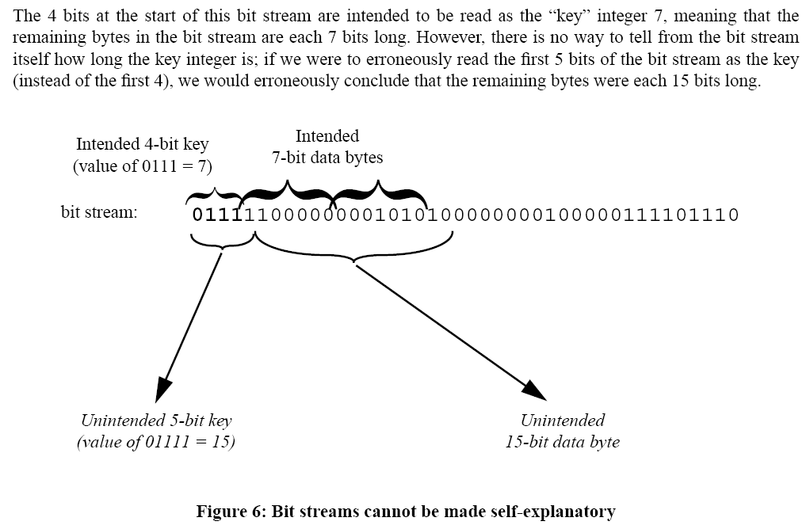
Rothenberg, 1999

Slide 71
Example of EXIF Metadata from a JPEG File (Generated Using exiftool*)
---- ExifTool ----
ExifTool Version Number : 9.38
---- System ----
File Name : IMG_20130823_151811.jpg
Directory : C:/Users/callee/Documents/images/digital-forensics-lab
File Size : 1785 kB
File Modification Date/Time : 2013:08:23 16:36:44-04:00
File Access Date/Time : 2013:10:14 17:13:02-04:00
File Creation Date/Time : 2013:08:23 16:36:44-04:00
File Permissions : rw-rw-rw-
---- File ----
File Type : JPEG
MIME Type : image/jpeg
Exif Byte Order : Big-endian (Motorola, MM)
Image Width : 2592
Image Height : 1944
Encoding Process : Baseline DCT, Huffman coding
Bits Per Sample : 8
Color Components : 3
Y Cb Cr Sub Sampling : YCbCr4:2:0 (2 2)
---- GPS ----
GPS Img Direction : 83
GPS Img Direction Ref : Magnetic North
GPS Latitude Ref : North
GPS Latitude : 35 deg 55' 2.24"
GPS Longitude Ref : West
GPS Longitude : 79 deg 2' 57.55"
GPS Altitude Ref : Above Sea Level
GPS Altitude : 0 m
GPS Time Stamp : 19:18:06
GPS Processing Method : NETWORK
GPS Date Stamp : 2013:08:23
---- IFD0 ----
Orientation : Unknown (0)
Camera Model Name : Galaxy Nexus
Modify Date : 2013:08:23 15:18:11
Y Cb Cr Positioning : Centered
Y Resolution : 72
Resolution Unit : inches
X Resolution : 72
Make : Samsung
---- ExifIFD ----
Create Date : 2013:08:23 15:18:11
Date/Time Original : 2013:08:23 15:18:11
Exif Version : 0220
Flash Energy : 0
Image Unique ID : OAEL01
Exposure Time : 1/17
ISO : 125, 0, 0
Scene Type : Directly photographed
Exposure Index : undef
Components Configuration : Y, Cb, Cr, -
F Number : 2.8
Compressed Bits Per Pixel : 0
Sensing Method : One-chip color area
Exposure Program : Aperture-priority AE
Aperture Value : 2.6
Brightness Value : 0
Subject Distance Range : Unknown
Shutter Speed Value : 1/15
Subject Distance : 0 m
Saturation : Normal
Color Space : sRGB
Contrast : Normal
Metering Mode : Multi-spot
Flashpix Version :
Exposure Compensation : 0
Exif Image Height : 1944
Max Aperture Value : 2.6
Sharpness : Normal
Exif Image Width : 2592
Focal Length : 3.4 mm
Digital Zoom Ratio : 1
Light Source : Fluorescent
Scene Capture Type : Standard
Flash : Off, Did not fire
Custom Rendered : Custom
White Balance : Auto
Exposure Mode : Auto
---- IFD1 ----
Compression : JPEG (old-style)
Image Width : 160
Image Height : 120
Thumbnail Offset : 1239
Thumbnail Length : 7164
---- Composite ----
Aperture : 2.8
GPS Altitude : 0 m Above Sea Level
GPS Date/Time : 2013:08:23 19:18:06Z
GPS Latitude : 35 deg 55' 2.24" N
GPS Longitude : 79 deg 2' 57.55" W
GPS Position : 35 deg 55' 2.24" N, 79 deg 2' 57.55" W
Image Size : 2592x1944
Shutter Speed : 1/17
Thumbnail Image : (Binary data 7164 bytes, use -b option to extract)
Focal Length : 3.4 mm
Light Value : 6.7
*http://www.sno.phy.queensu.ca/~phil/exiftool/ (Also available through the BitCurator environment)

Slide 72
Example of EXIF Metadata from a JPEG File (Generated Using exiftool*)
---- ExifTool ----
ExifTool Version Number : 9.38
---- System ----
File Name : IMG_20130823_151811.jpg
Directory : C:/Users/callee/Documents/images/digital-forensics-lab
File Size : 1785 kB
File Modification Date/Time : 2013:08:23 16:36:44-04:00
File Access Date/Time : 2013:10:14 17:13:02-04:00
File Creation Date/Time : 2013:08:23 16:36:44-04:00
File Permissions : rw-rw-rw-
---- File ----
File Type : JPEG
MIME Type : image/jpeg
Exif Byte Order : Big-endian (Motorola, MM)
Image Width : 2592
Image Height : 1944
Encoding Process : Baseline DCT, Huffman coding
Bits Per Sample : 8
Color Components : 3
Y Cb Cr Sub Sampling : YCbCr4:2:0 (2 2)
---- GPS ----
GPS Img Direction : 83
GPS Img Direction Ref : Magnetic North
GPS Latitude Ref : North
GPS Latitude : 35 deg 55' 2.24"
GPS Longitude Ref : West
GPS Longitude : 79 deg 2' 57.55"
GPS Altitude Ref : Above Sea Level
GPS Altitude : 0 m
GPS Time Stamp : 19:18:06
GPS Processing Method : NETWORK
GPS Date Stamp : 2013:08:23
---- IFD0 ----
Orientation : Unknown (0)
Camera Model Name : Galaxy Nexus
Modify Date : 2013:08:23 15:18:11
Y Cb Cr Positioning : Centered
Y Resolution : 72
Resolution Unit : inches
X Resolution : 72
Make : Samsung
---- ExifIFD ----
Create Date : 2013:08:23 15:18:11
Date/Time Original : 2013:08:23 15:18:11
Exif Version : 0220
Flash Energy : 0
Image Unique ID : OAEL01
Exposure Time : 1/17
ISO : 125, 0, 0
Scene Type : Directly photographed
Exposure Index : undef
Components Configuration : Y, Cb, Cr, -
F Number : 2.8
Compressed Bits Per Pixel : 0
Sensing Method : One-chip color area
Exposure Program : Aperture-priority AE
Aperture Value : 2.6
Brightness Value : 0
Subject Distance Range : Unknown
Shutter Speed Value : 1/15
Subject Distance : 0 m
Saturation : Normal
Color Space : sRGB
Contrast : Normal
Metering Mode : Multi-spot
Flashpix Version :
Exposure Compensation : 0
Exif Image Height : 1944
Max Aperture Value : 2.6
Sharpness : Normal
Exif Image Width : 2592
Focal Length : 3.4 mm
Digital Zoom Ratio : 1
Light Source : Fluorescent
Scene Capture Type : Standard
Flash : Off, Did not fire
Custom Rendered : Custom
White Balance : Auto
Exposure Mode : Auto
---- IFD1 ----
Compression : JPEG (old-style)
Image Width : 160
Image Height : 120
Thumbnail Offset : 1239
Thumbnail Length : 7164
---- Composite ----
Aperture : 2.8
GPS Altitude : 0 m Above Sea Level
GPS Date/Time : 2013:08:23 19:18:06Z
GPS Latitude : 35 deg 55' 2.24" N
GPS Longitude : 79 deg 2' 57.55" W
GPS Position : 35 deg 55' 2.24" N, 79 deg 2' 57.55" W
Image Size : 2592x1944
Shutter Speed : 1/17
Thumbnail Image : (Binary data 7164 bytes, use -b option to extract)
Focal Length : 3.4 mm
Light Value : 6.7
*http://www.sno.phy.queensu.ca/~phil/exiftool/ (Also available through the BitCurator environment)

Slide 73
Example of EXIF Metadata from a JPEG File (Generated Using exiftool*)
---- ExifTool ----
ExifTool Version Number : 9.38
---- System ----
File Name : IMG_20130823_151811.jpg
Directory : C:/Users/callee/Documents/images/digital-forensics-lab
File Size : 1785 kB
File Modification Date/Time : 2013:08:23 16:36:44-04:00
File Access Date/Time : 2013:10:14 17:13:02-04:00
File Creation Date/Time : 2013:08:23 16:36:44-04:00
File Permissions : rw-rw-rw-
---- File ----
File Type : JPEG
MIME Type : image/jpeg
Exif Byte Order : Big-endian (Motorola, MM)
Image Width : 2592
Image Height : 1944
Encoding Process : Baseline DCT, Huffman coding
Bits Per Sample : 8
Color Components : 3
Y Cb Cr Sub Sampling : YCbCr4:2:0 (2 2)
---- GPS ----
GPS Img Direction : 83
GPS Img Direction Ref : Magnetic North
GPS Latitude Ref : North
GPS Latitude : 35 deg 55' 2.24"
GPS Longitude Ref : West
GPS Longitude : 79 deg 2' 57.55"
GPS Altitude Ref : Above Sea Level
GPS Altitude : 0 m
GPS Time Stamp : 19:18:06
GPS Processing Method : NETWORK
GPS Date Stamp : 2013:08:23
---- IFD0 ----
Orientation : Unknown (0)
Camera Model Name : Galaxy Nexus
Modify Date : 2013:08:23 15:18:11
Y Cb Cr Positioning : Centered
Y Resolution : 72
Resolution Unit : inches
X Resolution : 72
Make : Samsung
---- ExifIFD ----
Create Date : 2013:08:23 15:18:11
Date/Time Original : 2013:08:23 15:18:11
Exif Version : 0220
Flash Energy : 0
Image Unique ID : OAEL01
Exposure Time : 1/17
ISO : 125, 0, 0
Scene Type : Directly photographed
Exposure Index : undef
Components Configuration : Y, Cb, Cr, -
F Number : 2.8
Compressed Bits Per Pixel : 0
Sensing Method : One-chip color area
Exposure Program : Aperture-priority AE
Aperture Value : 2.6
Brightness Value : 0
Subject Distance Range : Unknown
Shutter Speed Value : 1/15
Subject Distance : 0 m
Saturation : Normal
Color Space : sRGB
Contrast : Normal
Metering Mode : Multi-spot
Flashpix Version :
Exposure Compensation : 0
Exif Image Height : 1944
Max Aperture Value : 2.6
Sharpness : Normal
Exif Image Width : 2592
Focal Length : 3.4 mm
Digital Zoom Ratio : 1
Light Source : Fluorescent
Scene Capture Type : Standard
Flash : Off, Did not fire
Custom Rendered : Custom
White Balance : Auto
Exposure Mode : Auto
---- IFD1 ----
Compression : JPEG (old-style)
Image Width : 160
Image Height : 120
Thumbnail Offset : 1239
Thumbnail Length : 7164
---- Composite ----
Aperture : 2.8
GPS Altitude : 0 m Above Sea Level
GPS Date/Time : 2013:08:23 19:18:06Z
GPS Latitude : 35 deg 55' 2.24" N
GPS Longitude : 79 deg 2' 57.55" W
GPS Position : 35 deg 55' 2.24" N, 79 deg 2' 57.55" W
Image Size : 2592x1944
Shutter Speed : 1/17
Thumbnail Image : (Binary data 7164 bytes, use -b option to extract)
Focal Length : 3.4 mm
Light Value : 6.7
*http://www.sno.phy.queensu.ca/~phil/exiftool/ (Also available through the BitCurator environment)

Slide 74
Example of EXIF Metadata from a JPEG File (Generated Using exiftool*)
---- ExifTool ----
ExifTool Version Number : 9.38
---- System ----
File Name : IMG_20130823_151811.jpg
Directory : C:/Users/callee/Documents/images/digital-forensics-lab
File Size : 1785 kB
File Modification Date/Time : 2013:08:23 16:36:44-04:00
File Access Date/Time : 2013:10:14 17:13:02-04:00
File Creation Date/Time : 2013:08:23 16:36:44-04:00
File Permissions : rw-rw-rw-
---- File ----
File Type : JPEG
MIME Type : image/jpeg
Exif Byte Order : Big-endian (Motorola, MM)
Image Width : 2592
Image Height : 1944
Encoding Process : Baseline DCT, Huffman coding
Bits Per Sample : 8
Color Components : 3
Y Cb Cr Sub Sampling : YCbCr4:2:0 (2 2)
---- GPS ----
GPS Img Direction : 83
GPS Img Direction Ref : Magnetic North
GPS Latitude Ref : North
GPS Latitude : 35 deg 55' 2.24"
GPS Longitude Ref : West
GPS Longitude : 79 deg 2' 57.55"
GPS Altitude Ref : Above Sea Level
GPS Altitude : 0 m
GPS Time Stamp : 19:18:06
GPS Processing Method : NETWORK
GPS Date Stamp : 2013:08:23
---- IFD0 ----
Orientation : Unknown (0)
Camera Model Name : Galaxy Nexus
Modify Date : 2013:08:23 15:18:11
Y Cb Cr Positioning : Centered
Y Resolution : 72
Resolution Unit : inches
X Resolution : 72
Make : Samsung
---- ExifIFD ----
Create Date : 2013:08:23 15:18:11
Date/Time Original : 2013:08:23 15:18:11
Exif Version : 0220
Flash Energy : 0
Image Unique ID : OAEL01
Exposure Time : 1/17
ISO : 125, 0, 0
Scene Type : Directly photographed
Exposure Index : undef
Components Configuration : Y, Cb, Cr, -
F Number : 2.8
Compressed Bits Per Pixel : 0
Sensing Method : One-chip color area
Exposure Program : Aperture-priority AE
Aperture Value : 2.6
Brightness Value : 0
Subject Distance Range : Unknown
Shutter Speed Value : 1/15
Subject Distance : 0 m
Saturation : Normal
Color Space : sRGB
Contrast : Normal
Metering Mode : Multi-spot
Flashpix Version :
Exposure Compensation : 0
Exif Image Height : 1944
Max Aperture Value : 2.6
Sharpness : Normal
Exif Image Width : 2592
Focal Length : 3.4 mm
Digital Zoom Ratio : 1
Light Source : Fluorescent
Scene Capture Type : Standard
Flash : Off, Did not fire
Custom Rendered : Custom
White Balance : Auto
Exposure Mode : Auto
---- IFD1 ----
Compression : JPEG (old-style)
Image Width : 160
Image Height : 120
Thumbnail Offset : 1239
Thumbnail Length : 7164
---- Composite ----
Aperture : 2.8
GPS Altitude : 0 m Above Sea Level
GPS Date/Time : 2013:08:23 19:18:06Z
GPS Latitude : 35 deg 55' 2.24" N
GPS Longitude : 79 deg 2' 57.55" W
GPS Position : 35 deg 55' 2.24" N, 79 deg 2' 57.55" W
Image Size : 2592x1944
Shutter Speed : 1/17
Thumbnail Image : (Binary data 7164 bytes, use -b option to extract)
Focal Length : 3.4 mm
Light Value : 6.7
*http://www.sno.phy.queensu.ca/~phil/exiftool/ (Also available through the BitCurator environment)

Slide 75
Example of EXIF Metadata from a JPEG File (Generated Using exiftool*)
---- ExifTool ----
ExifTool Version Number : 9.38
---- System ----
File Name : IMG_20130823_151811.jpg
Directory : C:/Users/callee/Documents/images/digital-forensics-lab
File Size : 1785 kB
File Modification Date/Time : 2013:08:23 16:36:44-04:00
File Access Date/Time : 2013:10:14 17:13:02-04:00
File Creation Date/Time : 2013:08:23 16:36:44-04:00
File Permissions : rw-rw-rw-
---- File ----
File Type : JPEG
MIME Type : image/jpeg
Exif Byte Order : Big-endian (Motorola, MM)
Image Width : 2592
Image Height : 1944
Encoding Process : Baseline DCT, Huffman coding
Bits Per Sample : 8
Color Components : 3
Y Cb Cr Sub Sampling : YCbCr4:2:0 (2 2)
---- GPS ----
GPS Img Direction : 83
GPS Img Direction Ref : Magnetic North
GPS Latitude Ref : North
GPS Latitude : 35 deg 55' 2.24"
GPS Longitude Ref : West
GPS Longitude : 79 deg 2' 57.55"
GPS Altitude Ref : Above Sea Level
GPS Altitude : 0 m
GPS Time Stamp : 19:18:06
GPS Processing Method : NETWORK
GPS Date Stamp : 2013:08:23
---- IFD0 ----
Orientation : Unknown (0)
Camera Model Name : Galaxy Nexus
Modify Date : 2013:08:23 15:18:11
Y Cb Cr Positioning : Centered
Y Resolution : 72
Resolution Unit : inches
X Resolution : 72
Make : Samsung
---- ExifIFD ----
Create Date : 2013:08:23 15:18:11
Date/Time Original : 2013:08:23 15:18:11
Exif Version : 0220
Flash Energy : 0
Image Unique ID : OAEL01
Exposure Time : 1/17
ISO : 125, 0, 0
Scene Type : Directly photographed
Exposure Index : undef
Components Configuration : Y, Cb, Cr, -
F Number : 2.8
Compressed Bits Per Pixel : 0
Sensing Method : One-chip color area
Exposure Program : Aperture-priority AE
Aperture Value : 2.6
Brightness Value : 0
Subject Distance Range : Unknown
Shutter Speed Value : 1/15
Subject Distance : 0 m
Saturation : Normal
Color Space : sRGB
Contrast : Normal
Metering Mode : Multi-spot
Flashpix Version :
Exposure Compensation : 0
Exif Image Height : 1944
Max Aperture Value : 2.6
Sharpness : Normal
Exif Image Width : 2592
Focal Length : 3.4 mm
Digital Zoom Ratio : 1
Light Source : Fluorescent
Scene Capture Type : Standard
Flash : Off, Did not fire
Custom Rendered : Custom
White Balance : Auto
Exposure Mode : Auto
---- IFD1 ----
Compression : JPEG (old-style)
Image Width : 160
Image Height : 120
Thumbnail Offset : 1239
Thumbnail Length : 7164
---- Composite ----
Aperture : 2.8
GPS Altitude : 0 m Above Sea Level
GPS Date/Time : 2013:08:23 19:18:06Z
GPS Latitude : 35 deg 55' 2.24" N
GPS Longitude : 79 deg 2' 57.55" W
GPS Position : 35 deg 55' 2.24" N, 79 deg 2' 57.55" W
Image Size : 2592x1944
Shutter Speed : 1/17
Thumbnail Image : (Binary data 7164 bytes, use -b option to extract)
Focal Length : 3.4 mm
Light Value : 6.7
*http://www.sno.phy.queensu.ca/~phil/exiftool/ (Also available through the BitCurator environment)

Slide 76
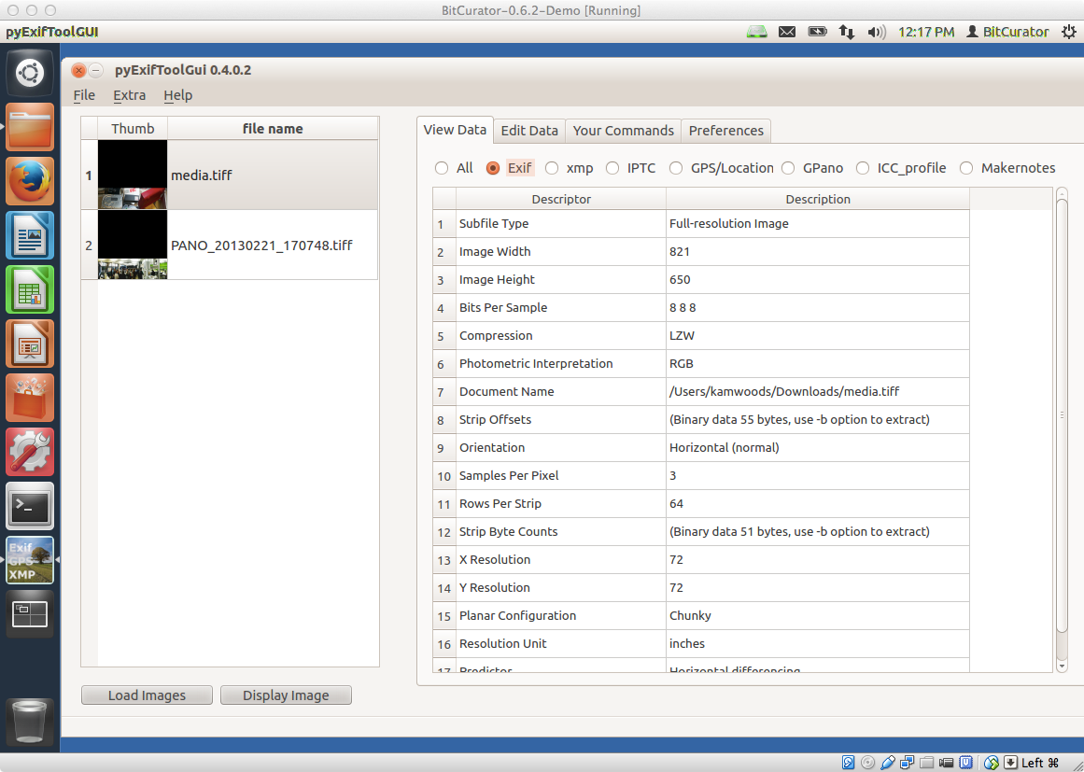
EXIF Metadata From Header of a TIFF File*
*Using pyExifToolGUI in the BitCurator environment

Slide 77
Not Just a Series of Bytes – Pointers and Offsets
Pointer – reference within a file or programming code that leads from one place to another
Causes the data to be read out of serial order (i.e. a jump from one place to another place that does not immediately follow it within the data stream)
Ability to resolve the pointer is essential
Offset – location that’s some given distance from a starting point
Location calculated by adding offset to a base address (location)
Again, ability to resolve the offset to the precise location within a bitstream is essential

Slide 78
Finding Representation Information Outside the File
Registries of representation information types (file formats):
Digital Formats Site - Library of Congress
Global Digital Format Registry (GDFR) - Harvard, with Mellon funding
PRONOM – the National Archives (UK)
Representation Information Registry – Digital Curation Centre (UK)
Unified Digital Format Registry (UDFR) - aimed to unify GDFR and PRONOM

Slide 79

File Information Tool Set (FITS) https://code.google.com/p/fits/
FITS “identifies, validates, and extracts technical metadata for various file formats. It wraps several third-party open source tools, normalizes and consolidates their output, and reports any errors. FITS was created by the Harvard University Library Office for Information Systems for use in its Digital Repository Service (DRS).”
Tools currently bundled into it:
Jhove
Exiftool
National Library of New Zealand Metadata Extractor
DROID
FFIdent
File Utility (windows)

Slide 80
Checksums – Compact Representations of Bitstreams
A given bitstream, fed into an algorithm, will generate a short string of characters that is extremely unlikely to be generated by a different bistream fed into that same algorithm
Most common = MD5, SHA-1
Can determine:
If bits have changed after a transfer
If bits have flipped within a storage environment
Whether two different files are identical bitstreams
A library of has values can identify “known and notable” (EnCase terminology) files
Known – files that can be ignored (e.g. software listed in National Software Reference Library)
Notable – specific bitstreams that you’re trying to find

Slide 81
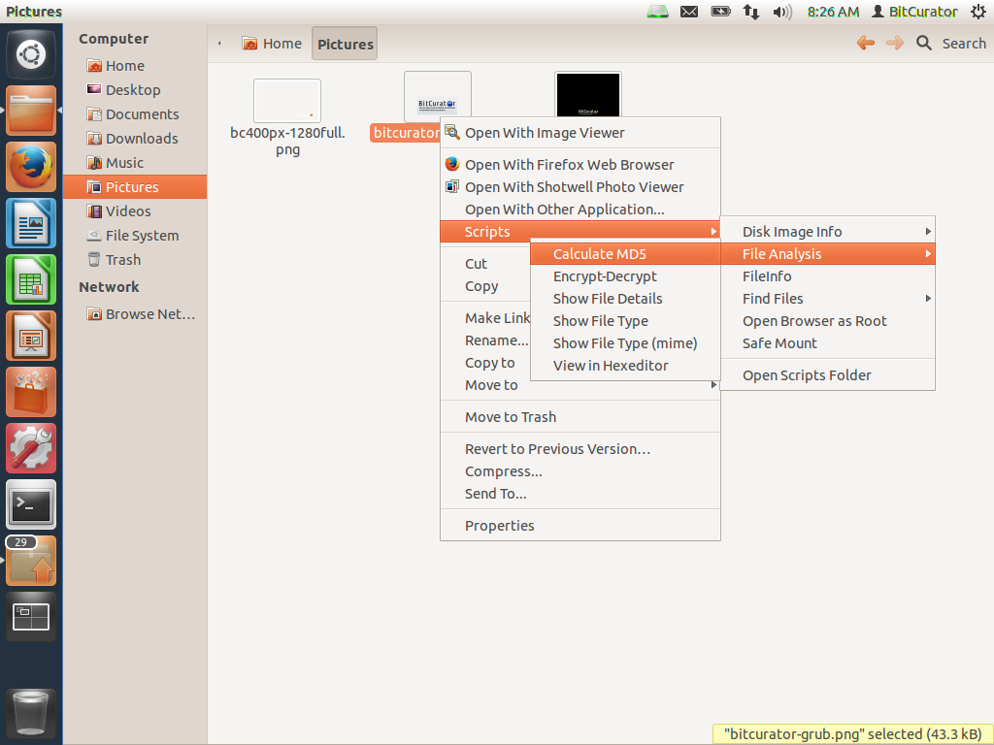
In BitCurator environment: Right Click on File or Directory and Calculate MD5

Slide 82
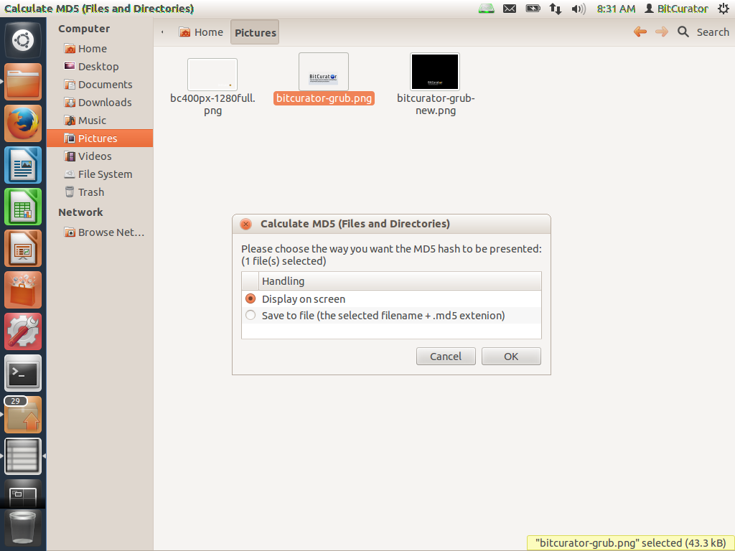

Slide 83
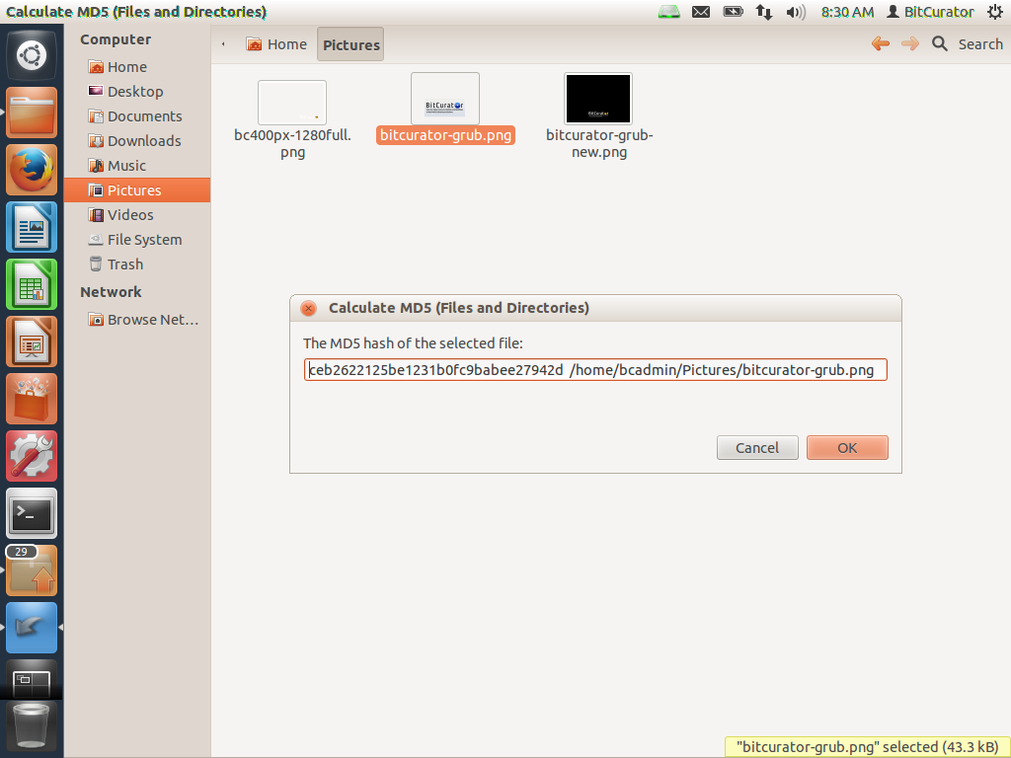

Slide 84
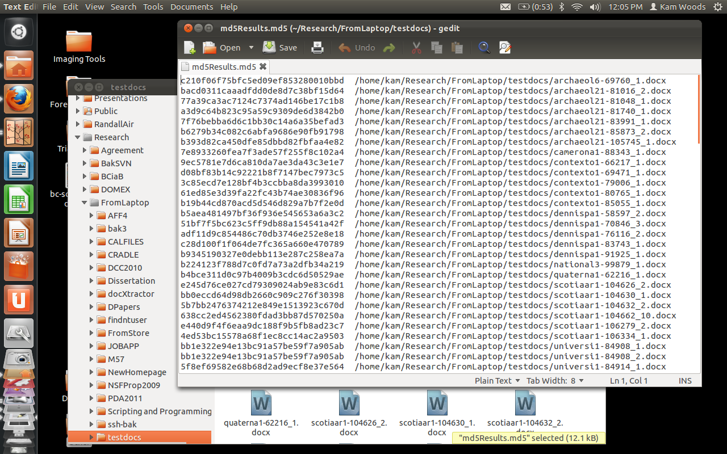
MD5 Hashes of an Entire Directory of Files

Slide 85
Bit-Level Representation of Individual Files Hex Dumps as Part of the Characterization Process

Slide 86
Hex Dump
A more compact and more humanly readable way of conveying a stream of bits
Uses hexadecimal notation
Each character represents one of 16 possible values (0,1,2,3,4,5,6,7,8,9,A,B,C,D,E,F)
Conveniently, a series of two characters represented in hexadecimal can represent exactly one byte (2⁸ = 256 possible values) of data, because 16² = 256
Hex dumps from computer’s memory often used for debugging or reverse engineering software & for data recovery

Slide 87
How to Generate a Hex Dump
Many free or inexpensive tools available for download, e.g. Cygnus Hex Editor, Hex Workshop, HexAssistant, HxD, Hex Fiend (Mac), GHex (Linux), MiniDumper*
Some online tools, e.g.: http://www.fileformat.info/tool/hexdump.htm
Hex viewing will usually include a separate view to the right that presents the ASCII equivalent of all bytes, which can help the human eye to detect patterns
Hex viewing only necessary when a file includes either non-ASCII strings of bits or corrupted file elements
If file is composed completely of ASCII-encoded data, using a text editor (e.g. Notepad) is simpler way to view file contents
* See http://en.wikipedia.org/wiki/Comparison_of_hex_editors

Slide 88
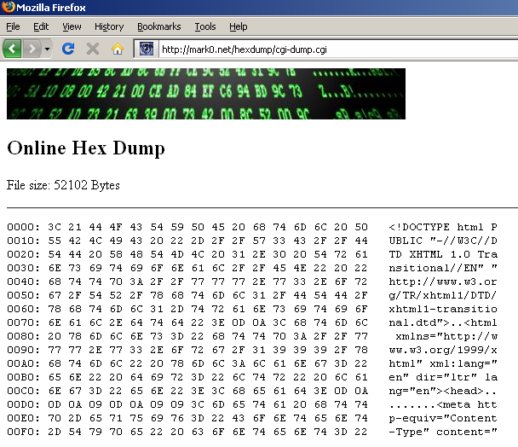
Web Page

Slide 89
Web Page
Beginning of file tells us what kind of file it is

Slide 90
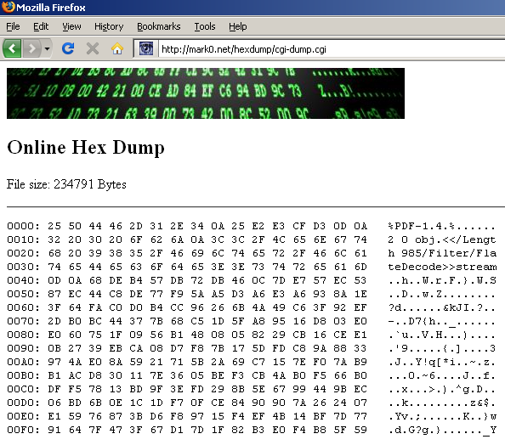
Slides from a class (PDF/A file)

Slide 91
Slides from a class (PDF/A file)
Contents of this PDF file are not as easy to read within ASCII view as the contents of the HTML file were, but note that, again, beginning of file tells us what kind of file it is

Slide 92
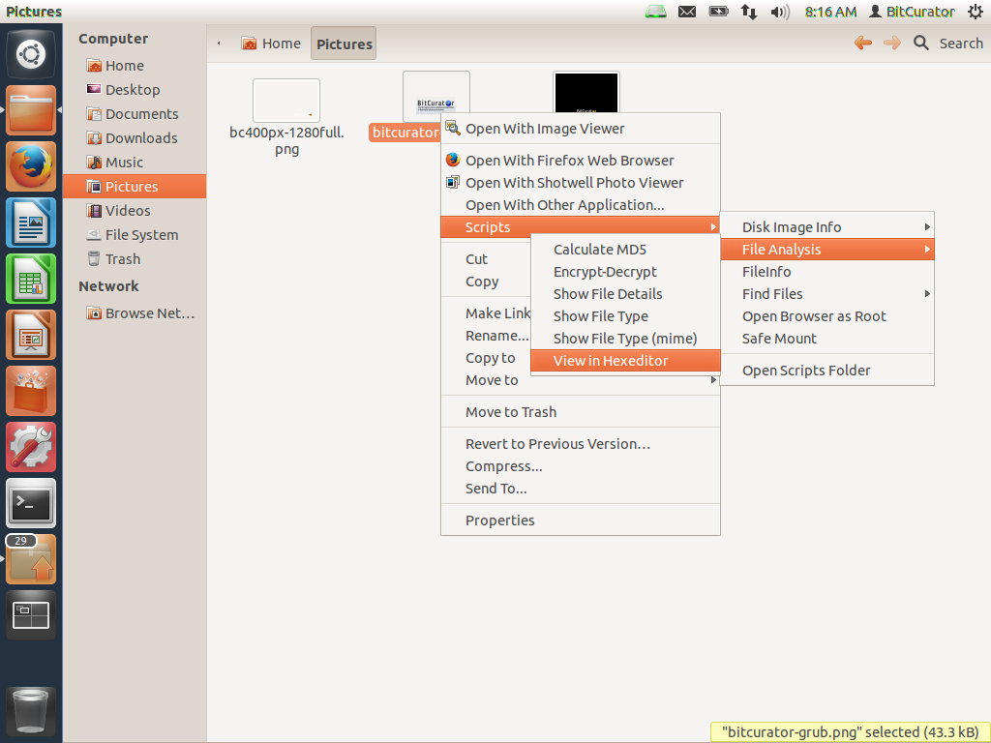
In the BitCurator environment:

Slide 93
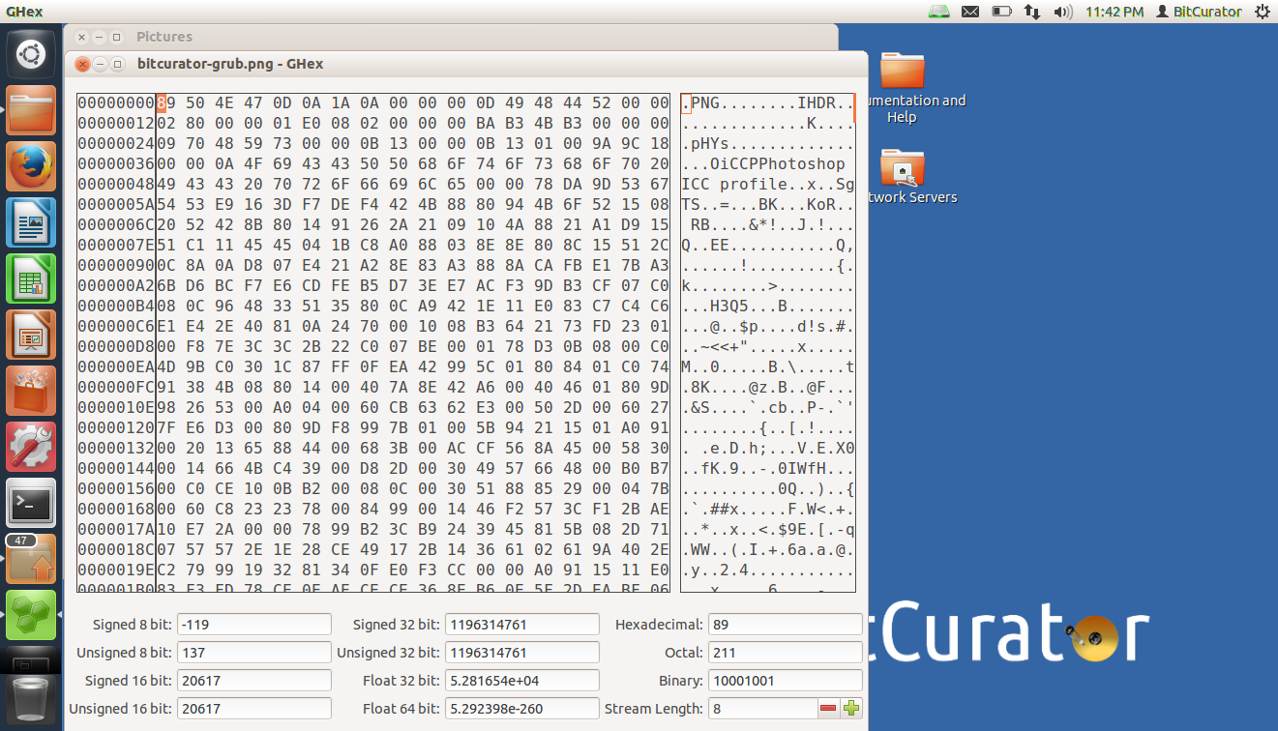

Slide 94
Let’s corrupt a bitstream.

Slide 95
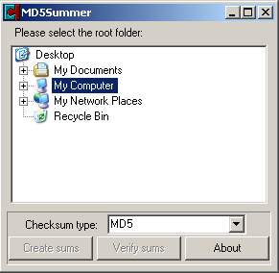

Slide 96
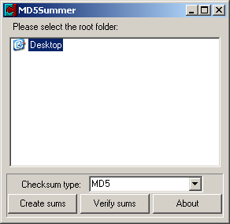

Slide 97
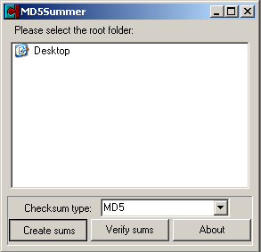

Slide 98
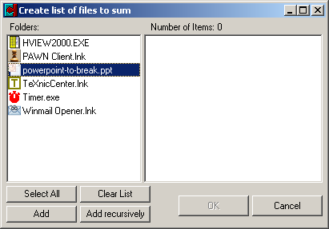

Slide 99
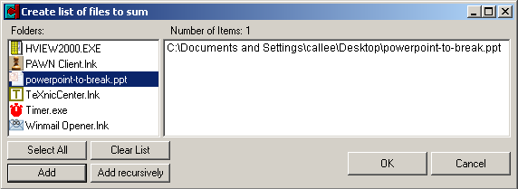

Slide 100
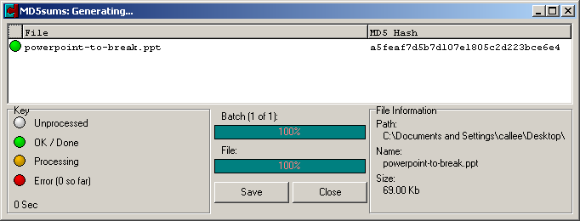

Slide 102
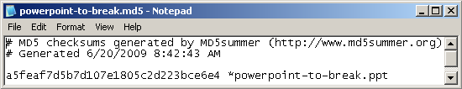

Slide 103
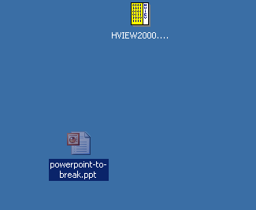

Slide 104
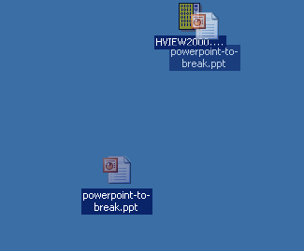

Slide 105
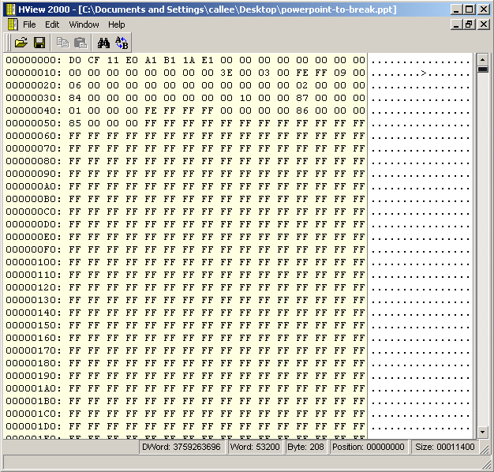

Slide 106
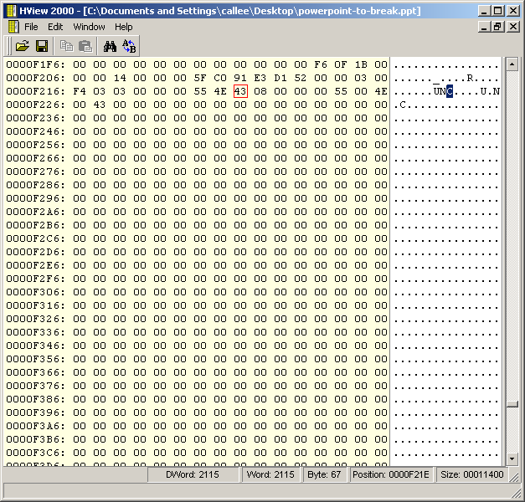

Slide 107
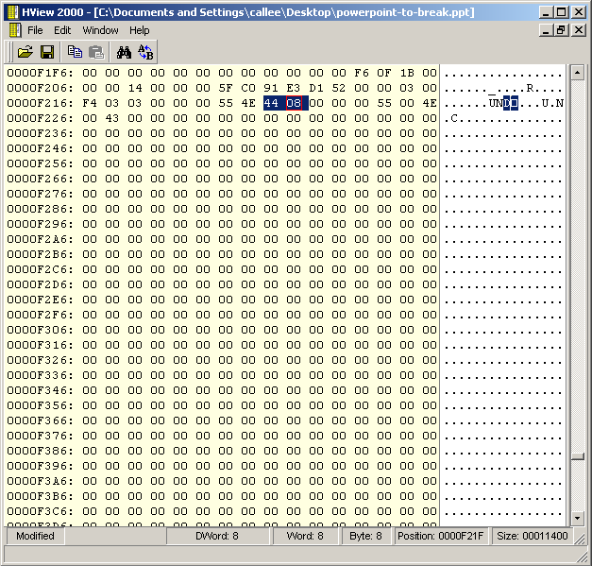

Slide 108
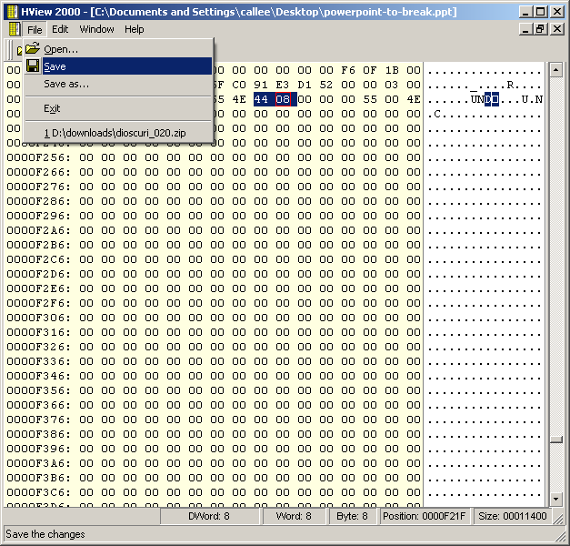

Slide 109
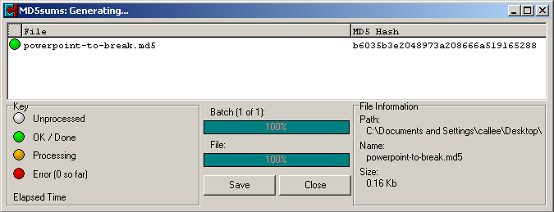

Slide 110
That doesn’t look right.
Let’s compare it to our previous MD5 hash...

Slide 111
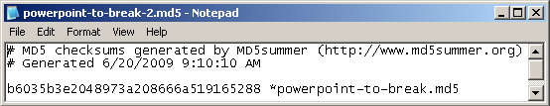

Slide 112
Before and After
File Name | Change Made | MD5 Hash
powerpoint-to-break.ppt | ------ | a5feaf7d5b7d107e1805c2d223bce6e4
powerpoint-to-break.ppt | One Bit Different From: Character “C” (Hex = 43) To: Character “D” (Hex = 44) | b6035b3e2048973a208666a519165288

Slide 113
Before and After
File Name | Change Made | MD5 Hash
powerpoint-to-break.ppt | ------ | a5feaf7d5b7d107e1805c2d223bce6e4
powerpoint-to-break.ppt | One Bit Different From: Character “C” (Hex = 43) To: Character “D” (Hex = 44) | b6035b3e2048973a208666a519165288
Note: A 1-byte change resulted in a completely different MD5 hash of the file.

Slide 114
Manually checking probably doesn’t scale so well. Let’s use software to verify the MD5 hash...

Slide 115
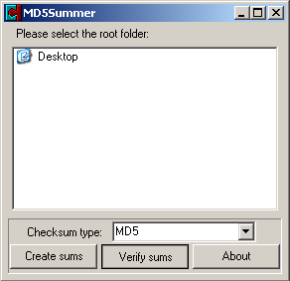

Slide 116
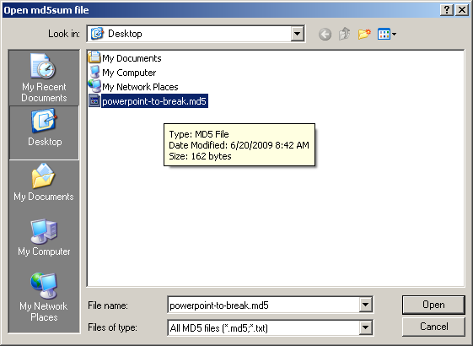

Slide 117
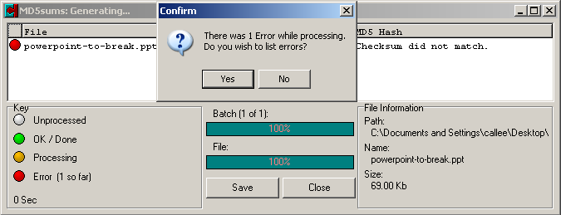

Slide 118
The computer agrees with us, so we must be right.

Slide 119
Characterization a level above the bitstream: identifying file types

Slide 120
Identifying File Types
Magic numbers and file signatures
File extensions
Metadata stored in file system
MIME types

Slide 121
Magic Numbers and File Signatures
Distinct string or pattern that is found within files of a given type (most often in the header)
Most effective searches for magic numbers often involve regular expressions (e.g. grep) in order to indicate multiple variations of a pattern
Utilities that use this: file (Unix), TrID, DROID
Examples:
File Format | Hex | ASCII
DOC | D0 CF 11 E0 A1 B1 1A E1 | ÐÏà¡±á
JPG | FF D8 FF | ÿØÿ
PDF | 25 50 44 46 2D 31 2E | %PDF-1.
ZIP | 50 4B 03 04 | PK..

Slide 122
File Extensions
Changing file extension usually changes default application that OS uses to open (i.e. associates with) the file
The “8.3” (eight characters, followed by three-character extension) limit in the past – based on FAT – resulted in many creative uses of the extension portion of file name (e.g. reports1.994, april-94.rpt)
Convention is often still to use only three letters
No authority for standardizing use, so three-letter extensions are often shared by many formats
Security risks associated with trusting the file extension to be accurate – malicious code masquerading as another type of file (e.g. viruses sent as email attachments)

Slide 123
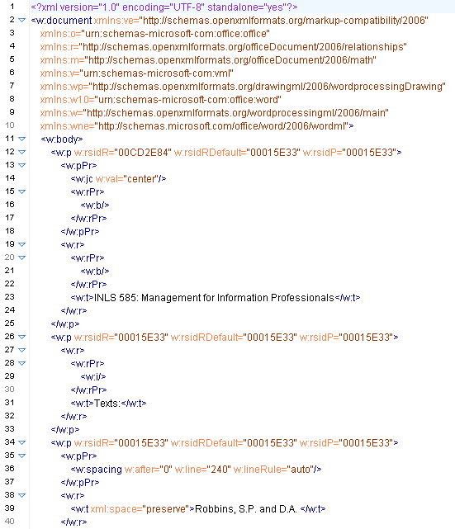
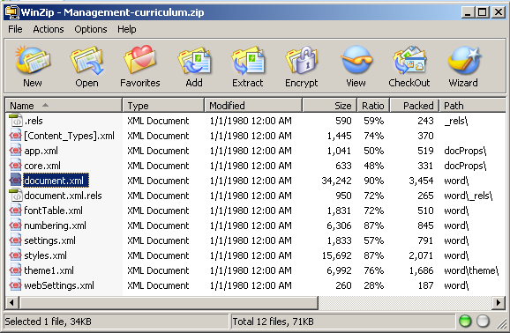

Slide 124
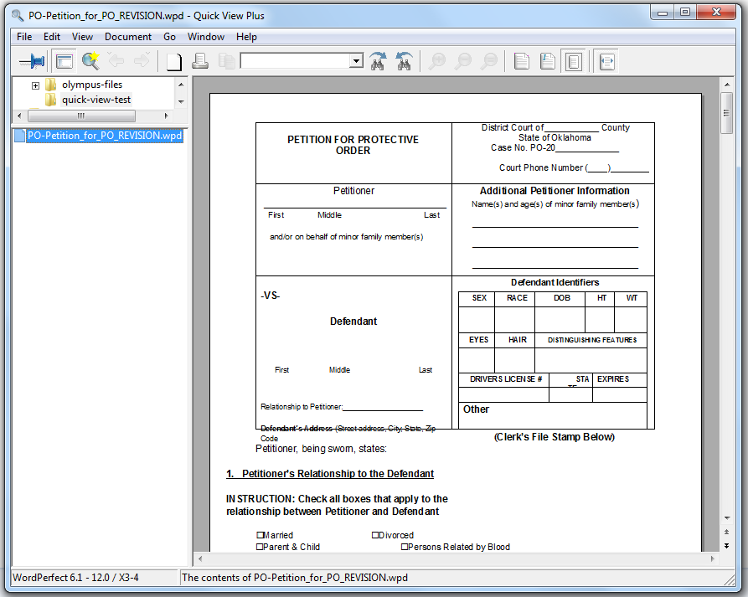
Reproducing In-Application Rendering (Sort of) of Digital Objects
Viewing a WordPerfect document on a computer that doesn’t have WordPerfect installed, using Quick View Plus

Slide 125
Source: “Information Management Approval Requirements.” OSC.

Slide 126
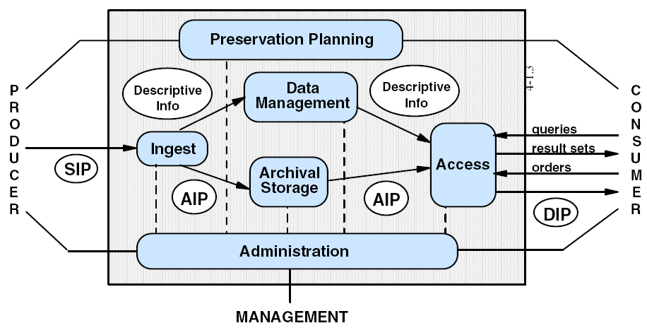
Reference Model for an Open Archival Information System, Figure 4-1: OAIS Functional Entities

